Slide 1
4. Internet Protocol Addressing and Subnetting

Slide 2
IPv4
As a network administrator, you will use the Transmission Control Protocol/Internet Protocol (TCP/IP) communications protocol suite most often.
Internet Protocol version 4 or IPv4 is the most frequently used communications protocol. IP resides on the network layer of the OSI model.

Slide 3
IP Addresses
IP addresses consist of four numbers, each being a 8-bit word, with a value between 0 and 255.
Examples include:
208.32.56.232
192.168.3.54
12.5.24.2
Binary format
11000000.10101000.00000101.00000011
(192.168.5.3)

Slide 4
IP Addresses
An IP address is formed by a Network ID and a Host ID
A subnet mask is used to identify the number of bit used for the network ID.
To connect to the Internet, you will also need a gateway address and DNS server address.
Here, gateway is refer to the router that a device is connected to

Slide 5
Binary – Decimal Conversion
Binary numbers are represented as a logical 0 or logical 1 in base 2 format.
each number has a place value of 2^{n} where n is the place value position of the binary digit.
The place value start at 2⁰ with the LSB (least significant bit position).
Example: the binary number 1 0 1 1 has the place values of 2⁰ the LSB position to 2³ for the MSB position.

Slide 6
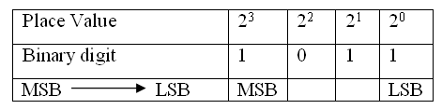
Place Value
1 0 1 1 = 1 x 2³ + 0 x 2² + 1 x 2¹ + 1 x 2⁰
= 11

Slide 7
Example
Problem: Given a 32-bit IP address number expressed in binary format, convert the number to a dotted-decimal format.
1 1 0 0 0 0 0 0 1 0 1 0 1 0 0 0 0 0 1 0 0 0 0 0 0 0 0 0 1 1 0 0
octet – 4 octet – 3 octet - 2 octet – 1
Solution:
192.168.32.12

Slide 8
Decimal to binary
The steps for converting decimal numbers to binary
Divide the decimal number by 2, record the remainder of 0 or 1 and write the quotient or result of the division by 2.
Divide the quotient by 2 and record the remainder of 0 or 1. Write the quotient and repeat this step until the quotient is 0.
Write the remainder numbers (0 and 1) in reverse order to obtain the binary equivalent value.

Slide 9
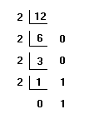
Example: Convert the decimal number, 12, to binary.
The answer is 1 1 0 0

Slide 10
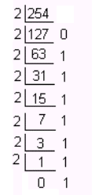
Example: Convert the decimal number 254 to binary.
Answer: 1111 1110

Slide 11
Hexadecimal Numbers
Hexadecimal numbers (HEX) are Base16 numbers.
It takes four binary numbers to represent a hexadecimal number. Notice that the letters A – F are used to represent the decimal numbers 10 to 15.

Slide 12
Hexadecimal conversion table
Decimal | Hexadecimal | Binary
0 | 0 | 0 0 0 0
1 | 1 | 0 0 0 1
2 | 2 | 0 0 1 0
3 | 3 | 0 0 1 1
4 | 4 | 0 1 0 0
5 | 5 | 0 1 0 1
6 | 6 | 0 1 1 0
7 | 7 | 0 1 1 1
8 | 8 | 1 0 0 0
9 | 9 | 1 0 0 1
10 | A | 1 0 1 0
11 | B | 1 0 1 1
12 | C | 1 1 0 0
13 | D | 1 1 0 1
14 | E | 1 1 1 0
15 | F | 1 1 1 1

Slide 13
Convert the following binary number to hexadecimal, 0 1 0 0 1 1 0 0 1 0 1 0
Solution:
Separate the binary numbers into groups of four beginning with the least significant bit position.
0 1 0 0 1 1 0 0 1 0 1 0
4 C A
The answer is 0x4CA.

Slide 14
Classful Network Architecture
The IPv4 classification system is known as the classful network architecture and is broken down into five classes, three of which are commonly used by hosts on networks—Classes A, B, and C.
The term node is synonymous with “host.”
If an IP address is Class A, the first octet is considered to be the “network” portion.

Slide 15
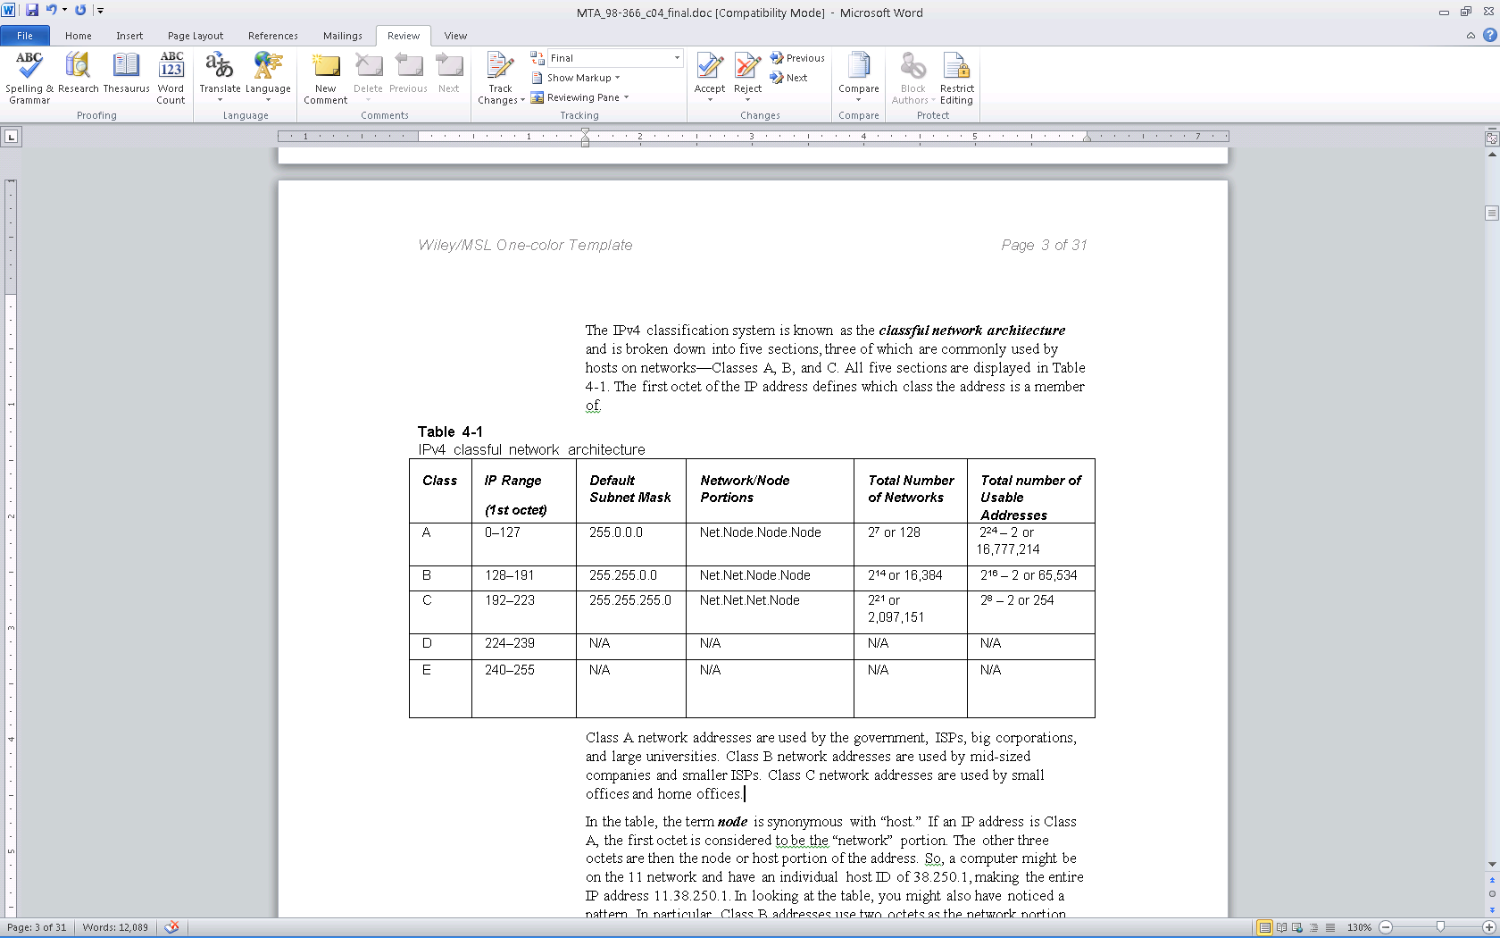
Classful Network Architecture
2,097,152
Class | Leading bits
A | 0
B | 10
C | 110
D | 1110
E | 1111

Slide 16
Exploring the Components of an IPv4 address
Classful IP addresses
Class A Address
Range 0 to 127
SM 255.0.0.0
0
10
(8 Bits)
110

Slide 17
Network ID and Host ID
Separating network ID and host ID

Slide 18
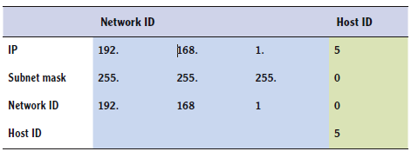
Network ID and Host ID
Separating network ID and host ID

Slide 19
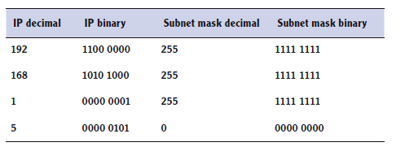
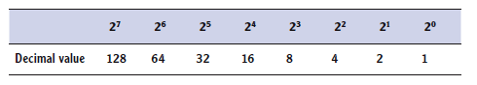
Exploring an IPv4 Address in Binary
Understanding the bits of an IP address

Slide 20
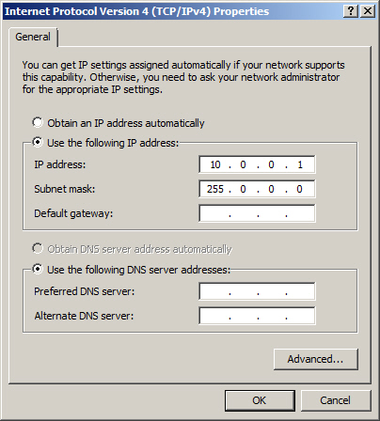
IPv4 properties using a Class A IP address

Slide 21
Exploring the Components of an IPv4 address
What’s wrong with this picture?

Slide 22
Loopback Testing
The range for Class A is 0–127.
The 127 network number isn’t used by hosts as a logical IP address. Instead, this network is used for loopback IP addresses, which allow for testing.
E.g. ping 127.0.0.1

Slide 23
Usable Addresses
Usable addresses is always going to be two less than the mathematical amount.
The first and last addresses can’t be used.
The 0 (in binary) for the host bits defines the entire network.
172.24.0.0 (the net id of a class B network)
The 1s (in binary) defines the known as the broadcast address,
172.24.255.255 (broadcast a message in the network 172.24.0.0)

Slide 24
Class D and E
Class D and Class E are not used by regular hosts.
Class D is used for what is known as multicasting — transmitting data to multiple computers.
All computers belonging to a multicast group
Class E was reserved for future use, but this has given way to IPv6 instead.

Slide 25
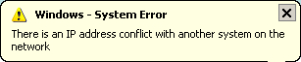
IP Conflict
Furthermore, it is important to avoid an IP conflict.
IP conflicts occur when two computers are configured with the same IP address

Slide 26
Public and Private Addresses
IPv4 addresses are further classified as either public or private. Public IP addresses are ones that are exposed to the Internet
Any other computers on the Internet can potentially communicate with them.
Private IP addresses are hidden from the Internet and any other networks.
They are usually behind an IP proxy or firewall device.
Intended to be used on internal networks called Intranets or home networks
These are called non-routable IP address

Slide 27
Private IP Addresses and NAT
Class A—10.0.0.0 to 10.255.255.255
Class B—172.16.0.0 to 172.31.255.255
Class C—192.168.0.0 to 192.168.255.255
These address type must be translated by a Network Address Translation (NAT) process on a server or router to Pubic IP addresses for Internet Access

Slide 28
APIPA
APIPA is an acronym for Automatic Private IP Addressing.
It uses a single Class B network number: 169.254.0.0.
IP address range is 169.254.0.1 through 169.254.255.254
If a Windows client cannot get an IP address from a DHCP server and has not been configured statically, it will auto-assign a number on this network.

Slide 29
Static and Dynamic Addresses
Static IP address are addresses that are manually assigned to a host.
Dynamic IP addresses are more common than static IP addresses, whereas they automatically obtain an IP address (and other IP information) from a DHCP Server.
Dynamic Host Configuration Protocol (DHCP)

Slide 30
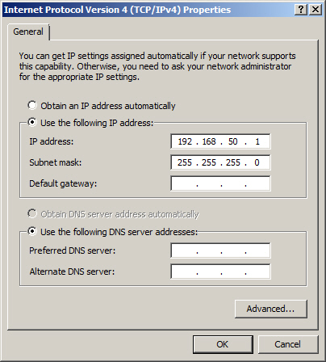
Static Addresses

Slide 31
DHCP
DHCP is short for Dynamic Host Configuration Protocol.
This protocol allows properly configured client computers to obtain IP addresses automatically from a DHCP server.
The IP information obtained might include the following:
IP addresses
Subnet masks
Gateway addresses
DNS server addresses
Other advanced options

Slide 32
DORA
DHCP sessions use a four-step process known as DORA.
Discovery: The client computer broadcasts out to the network in order to find a DHCP server.
Offering: The DHCP server sends out a unicast “offering” of an IP address to the client computer.
Request: The client broadcasts to all servers that it has accepted the offer.
Acknowledge: The DHCP server sends a final unicast to the client that includes the IP information the client will use.
DHCP utilizes ports 67 and 68.

Slide 33
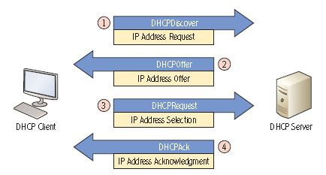
DHCP Operations

Slide 34
DHCP Server
DHCP servers can be installed on routers or Windows Servers
Installing a DHCP server on Windows Server consists of the following actions:
Installing the DHCP service
Configuring an IP scope
Activating the scope
Authorizing the server
Configuring advanced IP options (optional)

Slide 35
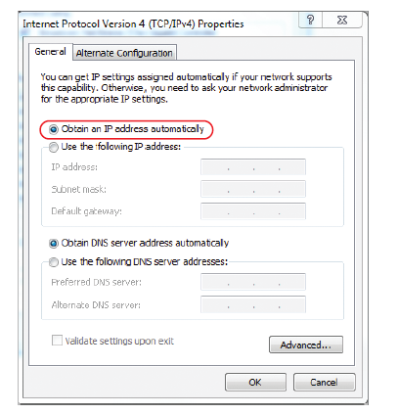
Using DHCP Service

Slide 36
Default Gateway and DNS Server
To have a fully functional computer, however, we also need to configure two more fields.
Default gateway - The first IP address of the device that a client computer will look for when attempting to gain access outside the local network.
DNS Server – The server that provides name resolution of host names to IP addresses

Slide 37

Default Gateway and DNS Server

Slide 38
Exploring the Components of an IPv4 address
Identifying the default gateway

Slide 39
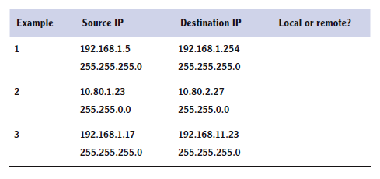
Exploring the Components of an IPv4 address
Determining local and remote addresses
255.0.0.0
255.0.0.0

Slide 40
Network Address Translation
Network address translation or NAT is the process of modifying an IP address while it is in transit across a router, computer, or similar device.
This is usually so one larger address space (private) can be re-mapped to another address space, or perhaps re-mapped to a single public IP address.
However, more advanced routers allow for port address translation (PAT), a subset of NAT, which translates both IP addresses and port numbers.

Slide 41
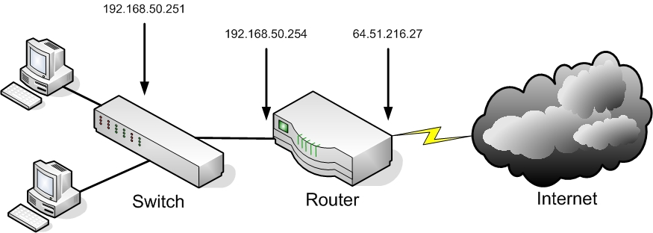
Network Address Translation

Slide 42
Subnetting
Subnetting is a technique used to break down (or partition) a network into smaller sub-networks, or subnets.
The subnets are created through the use of subnet masks.
The subnet mask identifies what bits in the IP address are to be used to represent the network/subnet portion of an IP address.

Slide 43
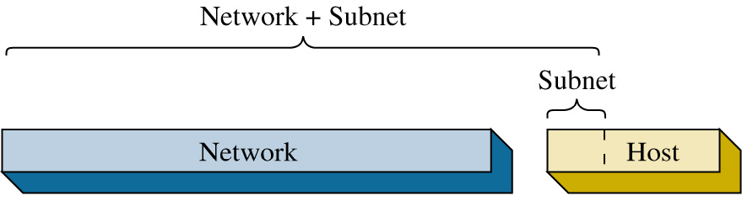
The subnets are created by borrowing bits from the host portion of the IP address.
The network portion of the IP address and the new subnet bits are used to define the new subnet. Routers use this information to properly forward data packets to the proper subnet.

Slide 44
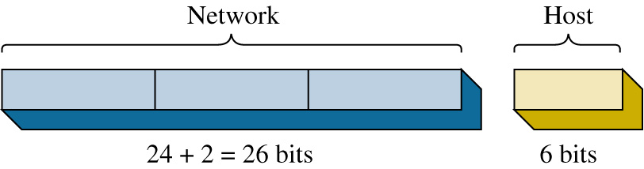
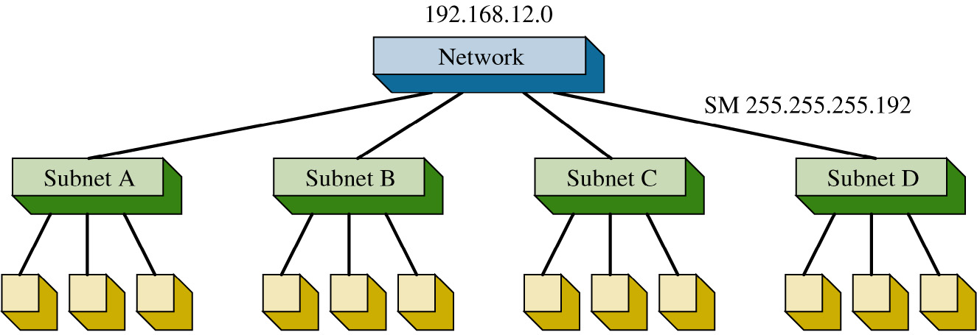
A Class C network is partitioned into four subnets. It takes 2 bits to provide four possible subnets therefore 2-bits are borrowed from the host bits.
This means the process of creating the four subnets reduces the number of bits available for host IP addresses.

Slide 45
Note:
All 0’s and all 1’s cannot be used as host address
Reserved for network and broadcast addresses
The equations for calculating the number of subnets created and the number of hosts/subnet:
# of subnets created = 2^{x}
# of hosts/subnet = 2^{(y-x)}-2
where x = # of bits borrowed from the host bits
y = # host bits for the class of the network
(A= 24, B=16, C=8)

Slide 46
The next step is to determine the subnet mask required for creating the four subnets.
The two MSB (most significant bit) positions, borrowed from the host and network portion of the IP address must be included in the subnet mask selection.
The purpose of the subnet mask is to specify the bit positions used to identify the network and subnet bits.
The subnet mask is 255.255.255.192
Network Host
24 + 2 = 26 bits 6 bits

Slide 47
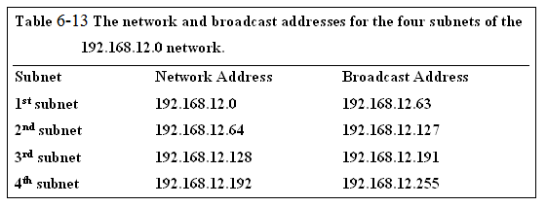
Breaking down the 192.168.12.0 network into four subnets required borrowing 2 host bits, therefore
x=2
y=8 (for a class C network)
The number of subnets created = 2² = 4
The number of hosts/subnet = 2⁽⁸⁻²⁾ – 2 = 62

Slide 48
Subnetting
For example: For a class C address 192.16.8.0, if 3 bits are used for subnetting
Subnet mask: 255.255.255.224
(last 8 bits: 1110 0000)
No. of subnets: 2³ = 8
No. of hosts per subnet: 2⁵ – 2 = 30
For the lowest subnet
Address range: 192.16.8.1 – 192.16.8.30
Subnet address: 192.16.8.0
Broadcast address: 192.16.8.31

Slide 49
Example
Given a network address of 10.0.0.0, divide the network into 8 subnets. Specify the subnet mask, the number of usable hosts/subnet, subnet addresses and broadcast addresses.
Answer:
Notes:
Subnet mask: 255.224.0.0
Number of hosts/subnet: 2²¹ – 2

Slide 50
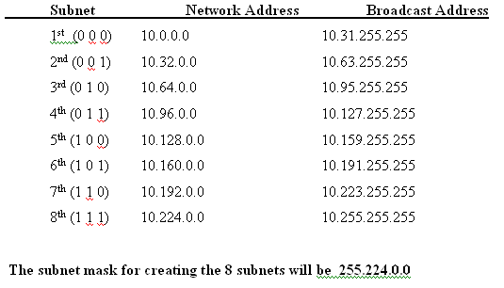

Slide 51
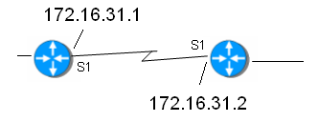
Example
Determine the subnet mask needed for the router link shown. Only two host addresses are required for this router-to-router link.
Answer: 255.255.255.252

Slide 52
Subnet Mask
Computer’s use the subnet mask to control data flow within network’s.
The subnet mask is used to determine if the destination IP address is intended for a host in the same LAN or if the data packet should be sent to the gateway IP address of the LAN.
The gateway IP address is typically the physical network interface on a layer 3 switch or a router.

Slide 53
Subnet Mask
For example, assume that the IP address of the computer in the LAN is 172.16.35.3.
A subnet mask of 255.255.255.0 is being used. This means that that all data packets with an IP address between 172.16.35.0 and 172.16.35.255 stay in the LAN.
A data packet with a destination IP address of 172.16.34.15 is sent to the LAN gateway. The 255.255.255.0 subnet mask indicates that all bits in the first three octets must match each other to stay in this LAN.

Slide 54
Destination Network ?
This can be verified by “ANDing” the subnet mask with the destination address as shown.
172. 16. 35.28
255.255.255.0
172. 16. 35.0 in the same subnet as the LAN
172. 16. 34.15
255.255.255 .0
172. 16. 34. 0 not in the same subnet as the LAN
- packet sent to the gateway

Slide 55
Classless Inter-Domain Routing (CIDR)
Classful address has a problem of not fully utilizing all addresses available
E.g. a class B address allows 2¹⁶ – 2 = 65534 hosts
CIDR is based on variable-length subnet masking (VLSM)

Slide 56
CIDR Notation
CIDR specifies an IP address range using a combination of an IP address and its associated network mask.
xxx.xxx.xxx.xxx/n
where n is the number of (leftmost) '1' bits in the mask.
For example,192.168.12.0/23
applies the network mask 255.255.254.0 to the 192.168 network, starting at 192.168.12.0.
This notation represents the address range 192.168.12.1 - 192.168.13.254.

Slide 57
Subnetting IPv4 - Example
A single class C network

Slide 58
Subnetting IPv4
Creating subnets
2⁷ (128) | 2⁶ (64) | Subnet Value | Four IP Ranges
0 | 0 | 192.168.1.0 | 192.168.1.1-62
0 | 1 | 192.168.1.64 | 192.168.1.65-126
1 | 0 | 192.168.1.128 | 192.168.1.129-190
1 | 1 | 192.168.1.192 | 192.168.1.193-254

Slide 59
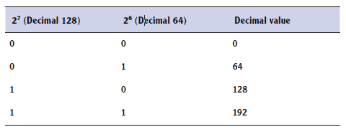
Subnetting IPv4
Subnetting with two high-order bits

Slide 60
Subnetting IPv4
A subnetted network
192.168.1.65 to 192.168.1.126
192.168.1.129 to 192.168.1.190

Slide 61
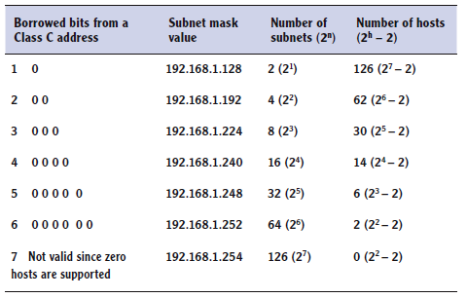
Subnetting IPv4
Determining the number of subnets and hosts in a Class C network

Slide 62
Subnetting IPv4
Applying Subnetting Knowledge
00

Slide 63
Subnetting IPv4
Applying Subnetting Knowledge
01
01

Slide 64
Subnetting IPv4
What’s wrong with this picture?
Notes:
Network A: address range 192.168.129.65 – 126
Network B: address range 10.80.160.1 – 10.80.191.254

Slide 65
Exercise
A company has an IP address 170.10.0.0 and is required to create 10 subnets. Answer the following questions and show all your working.
i) How many bits are to be borrowed for creating the subnets?
ii) What is the subnet mask?
iii) How many hosts are allowed in each subnet?
iv) What is the lowest subnet address?
v) What is the broadcast address of the lowest subnet?
vi) Give the IP address range for the subnet with the lowest subnet id.
Notes:
i) 4 bits, ii) 255.255.240.0, iii) 2¹² – 2 = 4094, iv) 170.10.0.0, v) 170.10.15.255, vi) 170.10.0.1 – 170.10.15.254

Slide 66
IPv6
IPv6 is the new generation of IP addressing for the Internet, but it can also be used in small office networks and home networks.
It was designed to overcome the limitations of IPv4, including address space and security.
IPv6 is a 128-bit system, whereas its still-dominant predecessor IPv4 is only a 32-bit system.
IPv4 can have approximately 4 billion IP addresses in the whole system
IPv6 can have 2¹²⁸ (340 undecillion) addresses. That’s 340 with 36 zeroes after it!
Notes:
Remember each bit doubles the number of available addresses

Slide 67
IPv6 Addresses
Provides unicast, multicast and anycast addressing
IPv6 unicast addresses are broken down into three parts:
Global routing prefix: This is the first three groups of numbers (48 bits), and it defines the “network” of the address.
IPv6 subnet: This defines the individual subnet of the network that the address is located on.
Interface ID: This is the individual host IP portion. It can be assigned to one interface or more than one interface, depending on the type of IPv6 address.

Slide 68
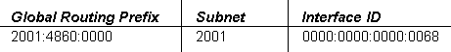
IPv6 Addresses
IPv6 numbers are written in hexadecimal rather than dotted decimal.
2001:4860:0000:2001:0000:0000:0000:0068
Notes:
You might want to mention that IPv6 addresses are expressed in hexadecimal digits. So you may see A, B, C, D, E and F.

Slide 69
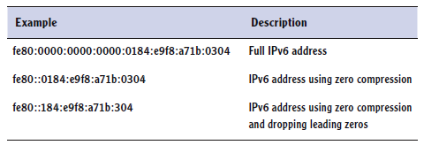
Displaying IPv6 Addresses
Hexadecimal
Zero compression
Dropping leading zeros

Slide 70
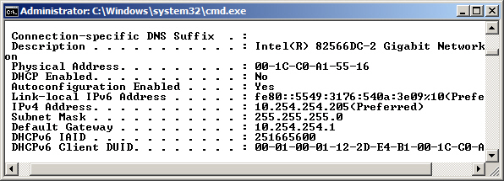
ipconfig /all Command

Slide 71
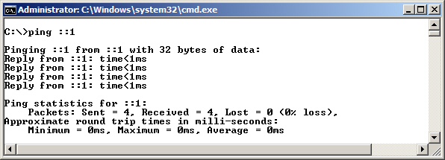
Testing IPv6 Loopback

Slide 72
IPv4 to IPv6 Migration
A dual IP stack exists when there are two Internet Protocol software implementations in an operating system, one for IPv4 and another for IPv6.
Dual stack IP hosts can run IPv4 and IPv6 independently, or they can use a hybrid implementation, which is the most commonly used method for modern operating systems.
IPv4 to IPv6 Tunneling - IPv6 packets can be encapsulated inside IPv4 datagrams.

Slide 73
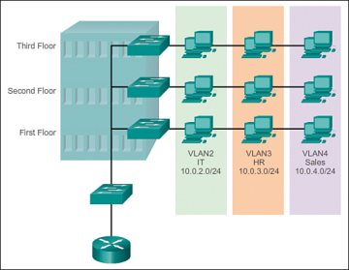
Virtual LAN (VLAN)
Recall: A switch is used to interconnect devices belonging to the same LAN
A switch can also be configured with VLANs where a group of computers are configured as if they are in the same LAN even if they reside across routers in separate LANs in different physical locations.

Slide 74
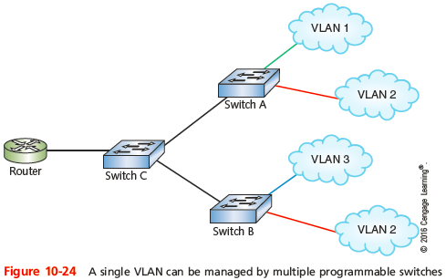
Virtual LAN (VLAN)
Advantage: computers and servers can be grouped in the same VLAN based on the organizational group (e.g. Sales, Engineering) even if they are not on the same physical segment or even the same building.

Slide 75
VLANs
Reasons for using VLANs:
Separating groups of users who need special security or network functions
Isolating connections with heavy or unpredictable traffic patterns
Identifying groups of devices whose data should be given priority handling
Containing groups of devices that rely on legacy protocols incompatible with the majority of the network’s traffic
Separating a large network into smaller subnets
Notes:
VLANs and Trunking
Reasons for using VLANs:
Separating groups of users who need special security or network functions
Isolating connections with heavy or unpredictable traffic patterns
Identifying groups of devices whose data should be given priority handling
Containing groups of devices that rely on legacy protocols incompatible with the majority of the network’s traffic
Separating a large network into smaller subnets

Slide 76
VLANs
To create a VLAN
You need a programmable physical switch whose ports can be partitioned into groups
Each VLAN is assigned its own subnet of IP addresses
Each VLAN and subnet normally is a broadcast domain
A VLAN can include ports from more than one switch
802.1Q
The IEEE standard that specifies how VLAN information appears in frames and how switches interpret that information
Notes:
VLANs and Trunking
VLAN (virtual local area network)
Groups ports on a switch so that some of the local traffic on the switch is forced to go through a router
To create a VLAN
You need a programmable physical switch whose ports can be partitioned into groups

Slide 77
Trunking
Trunk
A single physical connection between switches through which many logical VLANs can transmit and receive data
A port on a switch is configured as either an access port or a trunk port
Access port - used for connecting a single node, e.g. a PC
Trunk port - capable of managing traffic among multiple VLANs
Notes:
VLANs and Trunking
Trunk
A single physical connection between switches through which many logical VLANs can transmit and receive data
A port on a switch is configured as either an access port or a trunk port
Access port - used for connecting a single node
Trunk port - capable of managing traffic among multiple VLANs

Slide 78
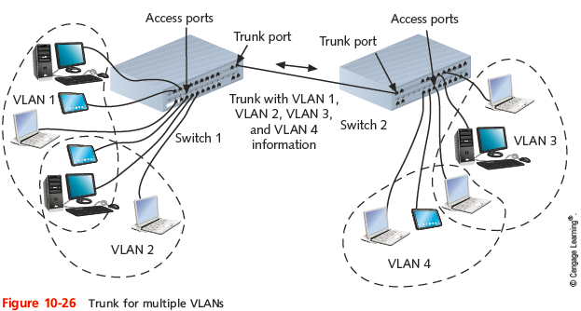
VLANs and Trunking
Notes:
VLANs and Trunking

Slide 79
VLANs and Trunking
To keep data belonging to each VLAN separate
Each frame is identified with a VLAN identifier or tag according to 802.1Q
Trunking protocols assign and interpret these tags
Potential problem in creating VLANs
By grouping certain nodes, you are excluding another group
To allow different VLANs to exchange data
You need to connect VLANs with a router
Notes:
VLANs and Trunking
To keep data belonging to each VLAN separate
Each frame is identified with a VLAN identifier or tag
Trunking protocols assign and interpret these tags
Cisco’s VTP (VLAN trunking protocol)
The most popular protocol for exchanging VLAN information over trunks
VTP allows changes to VLAN database on one switch, called the stack master, to be communicated to all other switches in the network

Slide 80
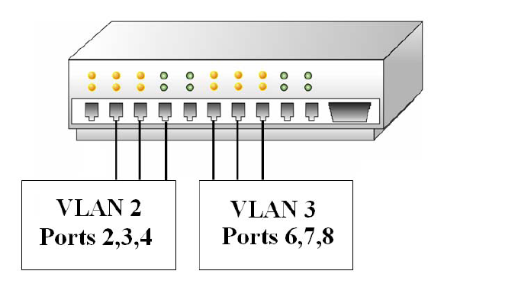
VLANs
There are three types of VLANs; port-based, tag-based, and protocol-based
Port-based VLAN: the host computers connected to specific ports on a switch are assigned to a specific VLAN.
E.g., assume the computers connected to switch ports 2, 3, and 4 are assigned to the Sales VLAN 2 while the computers connected to switch ports 6, 7, and 8 are assigned to the Engineering VLAN 3.

Slide 81
Port-based VLANs
The switch will be configured as a port-based VLAN so that the groups of ports [2,3,4] are assigned to the sales VLAN while ports [6,7,8] belong to the Engineering VLAN.
The devices assigned to the same VLAN will share broadcasts for that LAN
Computers that are connected to ports not assigned to the VLAN will not share the broadcasts.

Slide 82
Tag-based VLANs
A tag is added to the Ethernet frames
This tag contains the VLAN ID that is used to identify that a frame belongs to a specific VLAN.
This is based on the 802.1Q specification.
Use for trunking
A switch port belongs to more than one VLAN.

Slide 83
Protocol-Based VLANs
Data traffic is connected to specific ports based on the type of protocol being used.
The packet is dropped when it enters the switch if the protocol doesn’t match any of the VLANs.
For example, an IP network could be set up for the Engineering VLAN on ports 6,7,8 and an IPX network for the Sales VLAN on ports 2,3, and 4.
The advantage of this is the data traffic for the two networks is separated.

Slide 84
VLAN membership
There are two approaches for assigning VLAN membership:
A static VLAN is basically a port-based VLAN
The assignments are created when ports are assigned to a specific VLAN.
In a dynamic VLAN, ports are assigned to a VLAN based on either the computer’s MAC address or the username of the client logged onto the computer.
The system has been previously configured with the VLAN assignments for the computer or the username.
The advantage of this is the username and/or the computer can move to a different location but VLAN membership will be retained.

